Slide 3
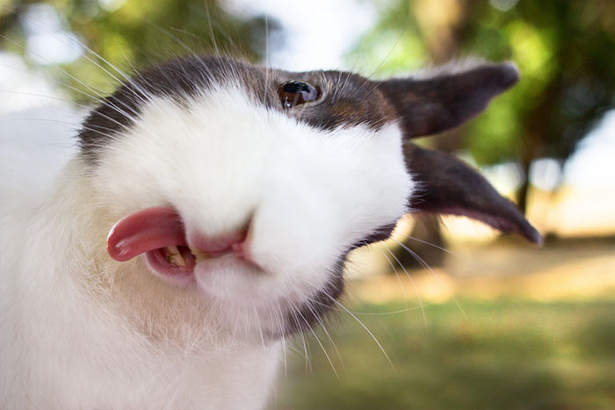

Slide 4
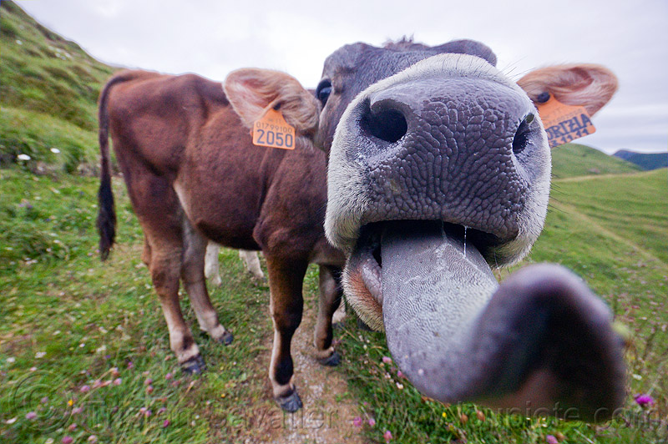

Slide 6
“The tongue is a small thing, but what enormous damage it can do.” James 3:5

Slide 7
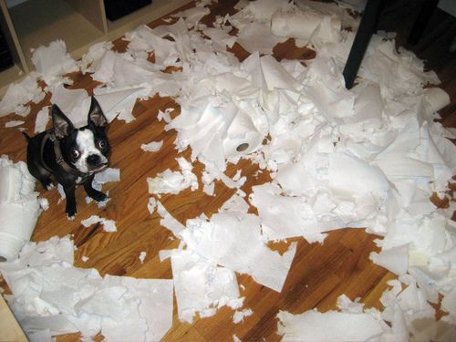

Slide 8
“Keep your tongue from evil.” Psalm 34:13

Slide 10
“Encourage one another and build each other up.” 1 Thessalonians 5:11

Slide 12
“A soft answer turns away wrath.” Proverbs 15:1

Slide 14
“I will praise the Lord at all times; His praise will ever be on my lips.” Psalm 34:1

